Slide 1
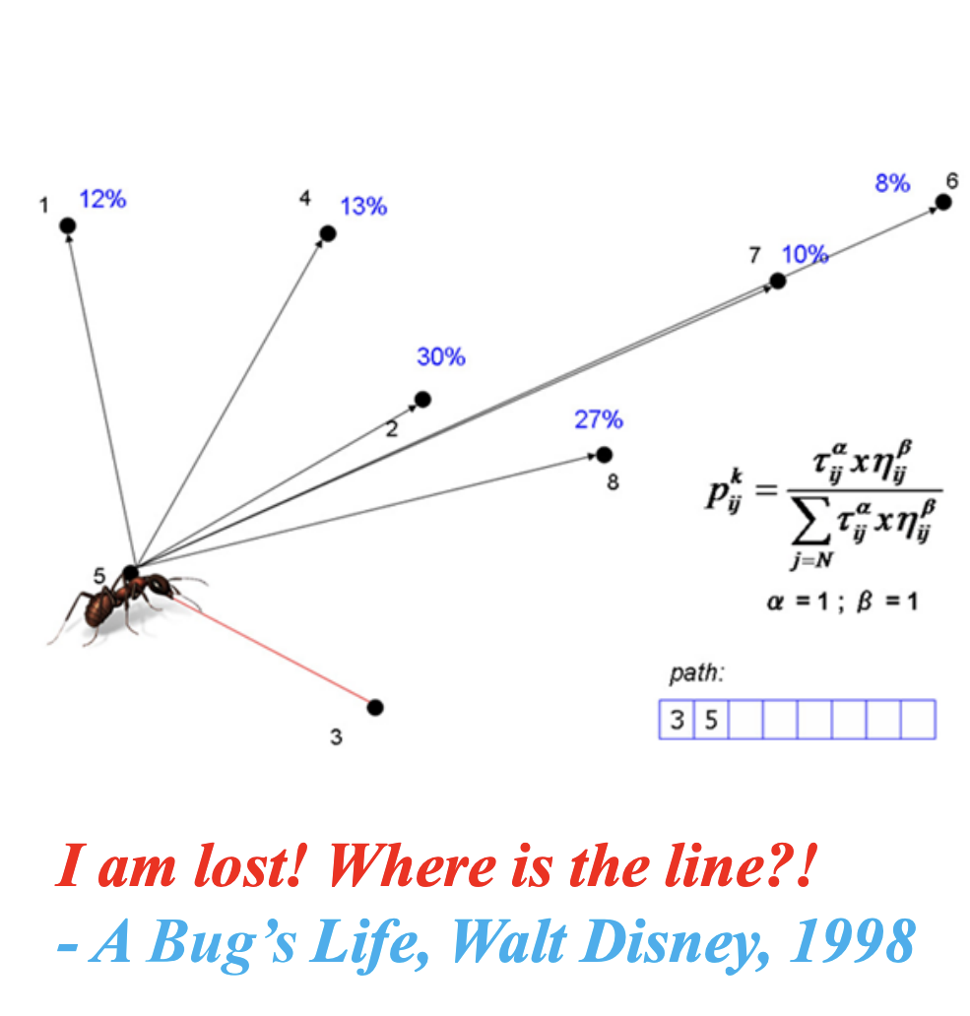
Ant Colony Optimization (ACO)

Slide 2
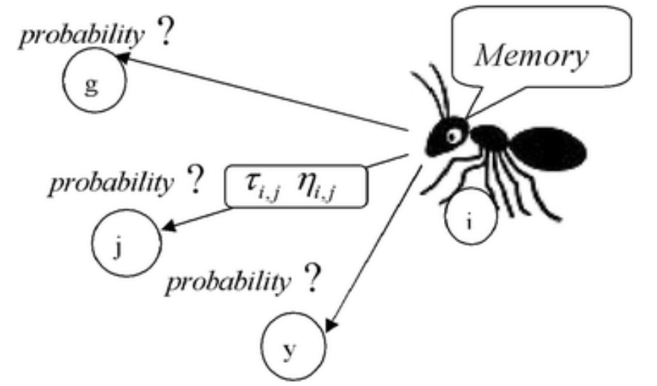
Ant Colony Optimization (ACO)
Inspired by the behavior of real ants.
ACO is a population-based, general search technique which is inspired by the pheromone trail laying behavior of real ant colonies.
Proposed by Marco Dorigo in 1991.
Multi-agent approach for solving difficult combinatorial optimization problems.

Slide 3
A key concept: Stigmergy
Stigmergy is:
indirect communication via interaction with the environment [Gassé, 59]
A problem gets solved bit by bit ..
Individuals communicate with each other in the above way, affecting what each other does on the task.
E.g. sorting things into piles, as we did in the Introductory Swarm Intelligence lecture
Individuals leave markers or messages – these don’t solve the problem in themselves, but they affect other individuals in a way that helps them solve the problem …
E.g. as we will see, this is how ants find shortest paths.

Slide 4
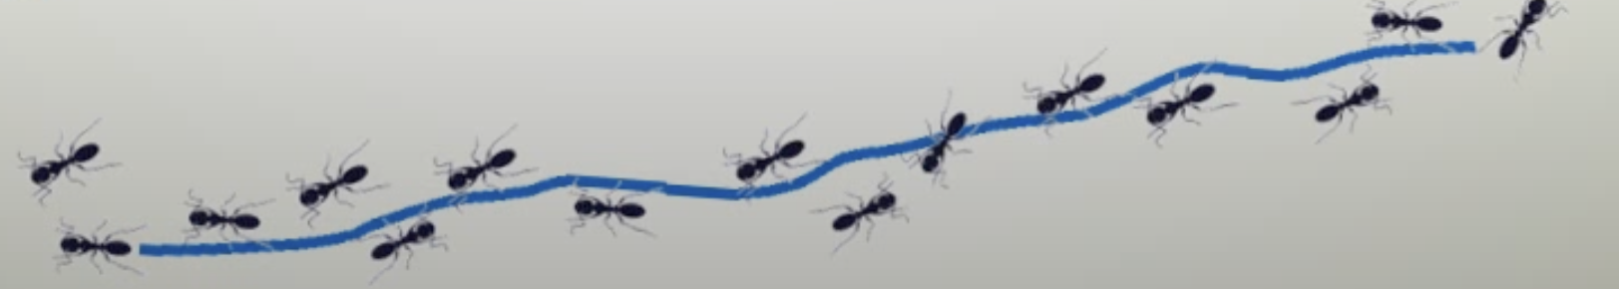
Stigmergy in Ants
Ants are behaviorally unsophisticated, but collectively they can perform complex tasks.
Ants have highly developed sophisticated sign-based stigmergy
They communicate using pheromones;
They lay trails of pheromone that can be followed by other ants.
If an ant has a choice of two pheromone trails to follow, one to the NW, one to the NE, but the NW one is stronger – which one will it follow?

Slide 5
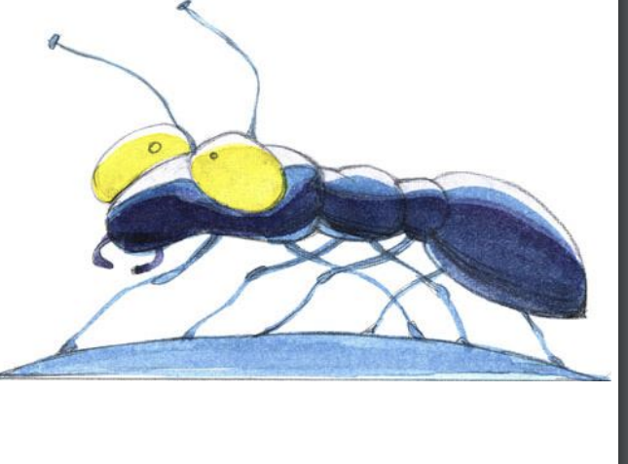
Stigmergy in Ants
Almost blind.
Incapable of achieving complex tasks alone.
Limited ability to sense local environment.
Act concurrently and independently.
High quality solutions emerge via global cooperation.

Slide 6
Big takeaways
Ants will choose to follow trails with higher pheromone levels with a a higher probability than trails with lowe pheromone levels.
As more ants use a path the pheromone trail grows stronger
This results in autocatalytic behavior, as more ants follow the trail, the trail becomes increasingly attractive

Slide 7
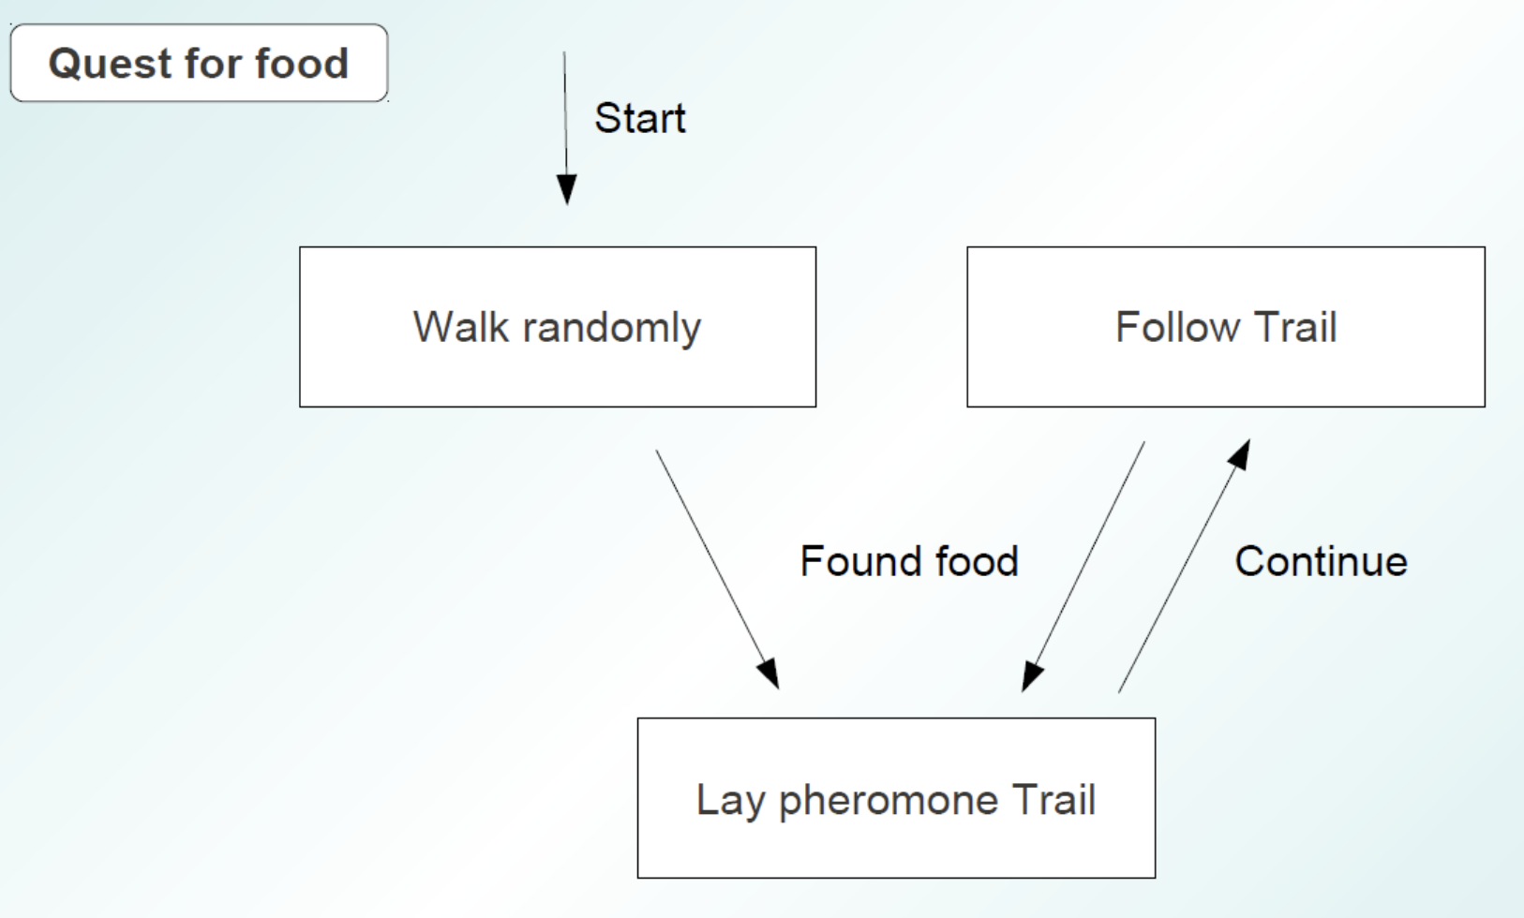
Ant Behavıor

Slide 8
Pheromone Trails
Individual ants lay pheromone trails while travelling from the nest, to the nest or possibly in both directions.
The pheromone trail gradually evaporates over time.
But pheromone trail strength accumulate with multiple ants using path.
_{Nest}
_{Food source}

Slide 9
Ant Foraging
Two ants start with equal probability of going on either path.

Slide 10
Ant Foraging
The ant on shorter path has a shorter to-and-fro time from it’s nest to the food.

Slide 11
Ant Foraging
The density of pheromone on the shorter path is higher because of 2 passes by the ant (as compared to 1 by the other).

Slide 12
Ant Foraging
The next ant takes the shorter route.

Slide 13
Ant Foraging
Over many iterations, more ants begin using the path with higher pheromone, thereby further reinforcing it.

Slide 14
Ant Foraging
After some time, the shorter path is almost exclusively used.

Slide 15
Pheromone Trails continued
Initial state:
no ants
τ = 15
τ = 30
τ = 15
τ = 30

Slide 16
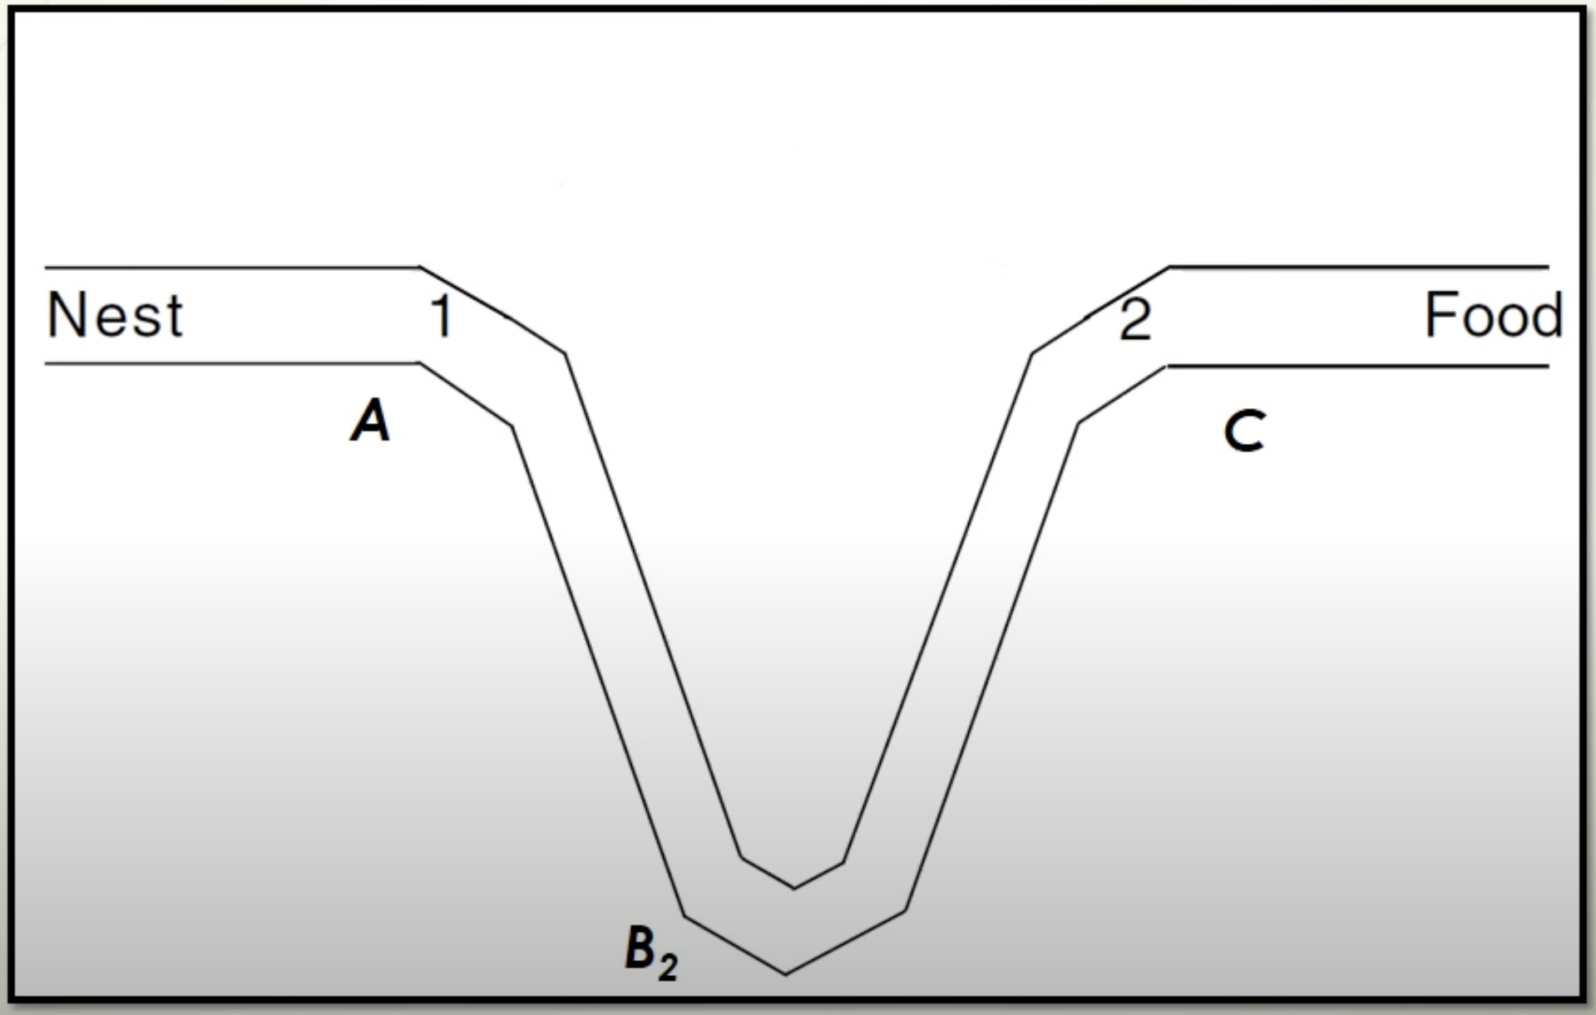
Opportunity Missed

Slide 17
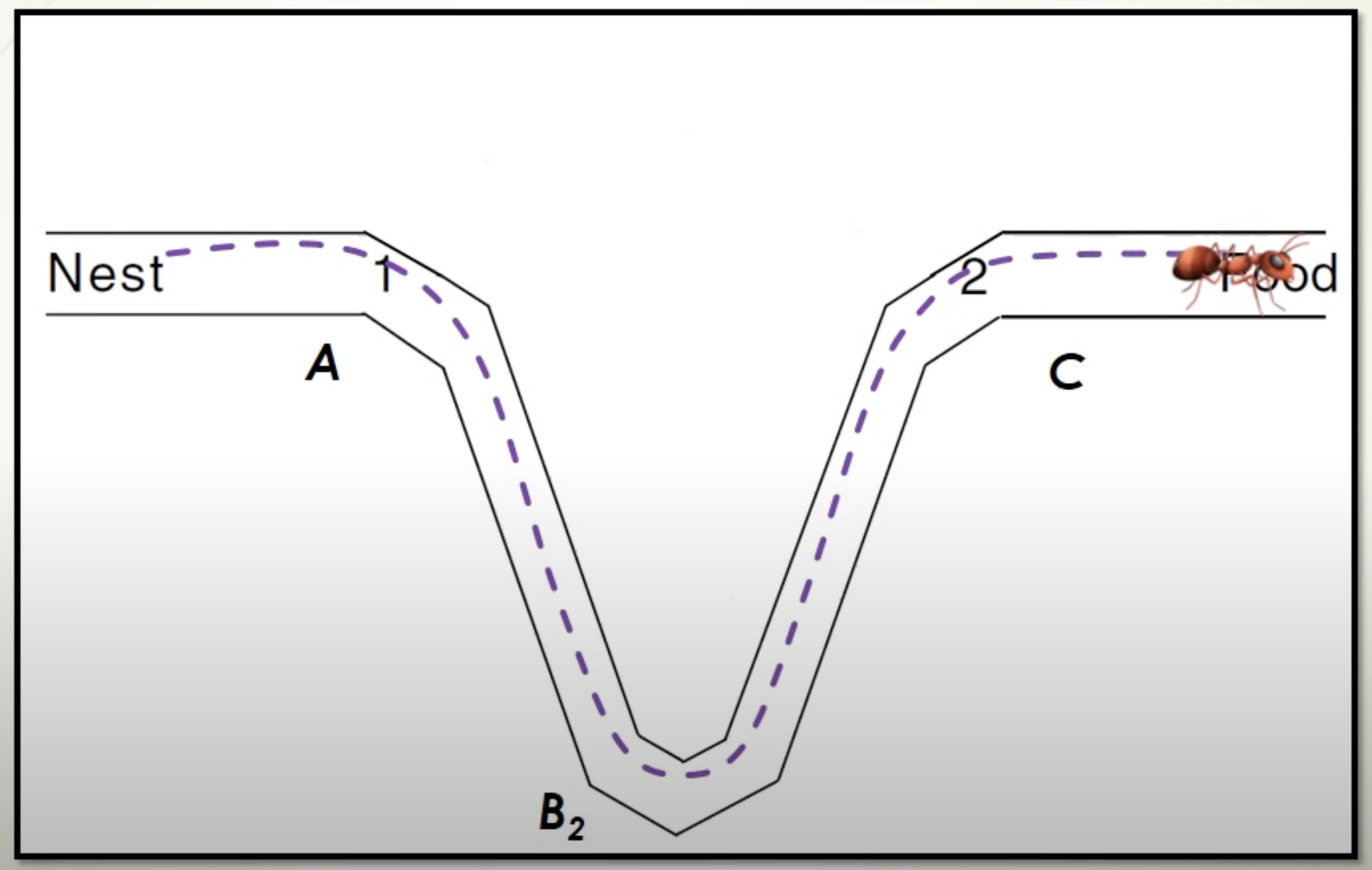
Opportunity Missed

Slide 18
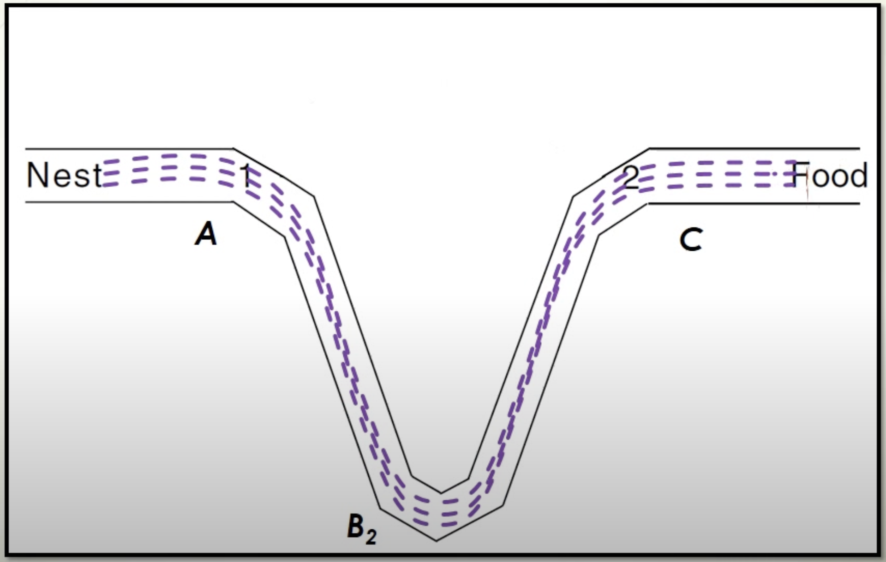
Opportunity Missed

Slide 19
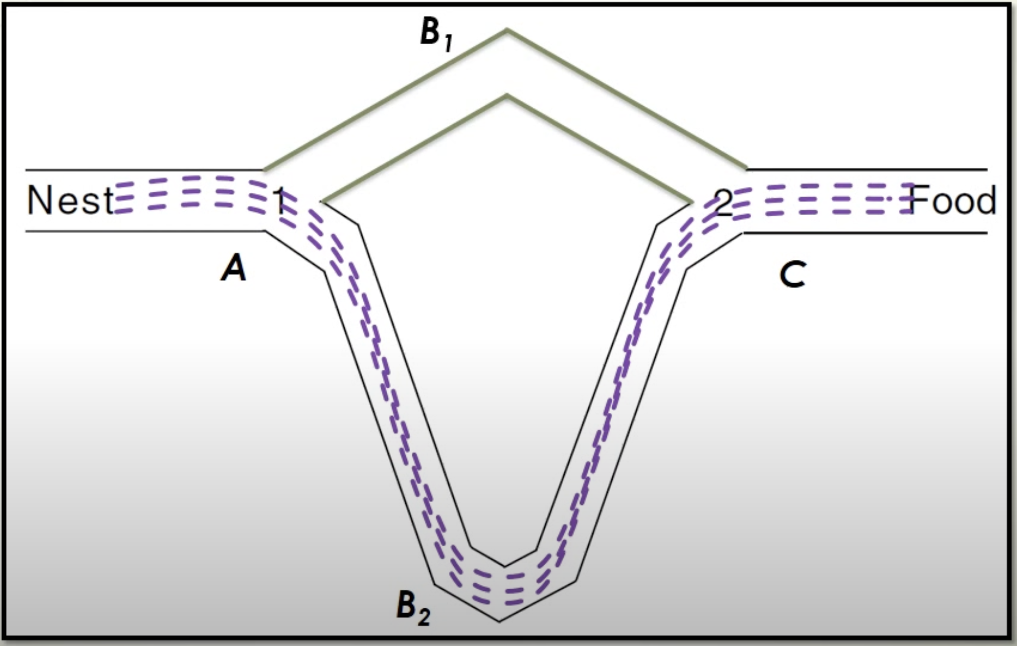
Opportunity Missed

Slide 20
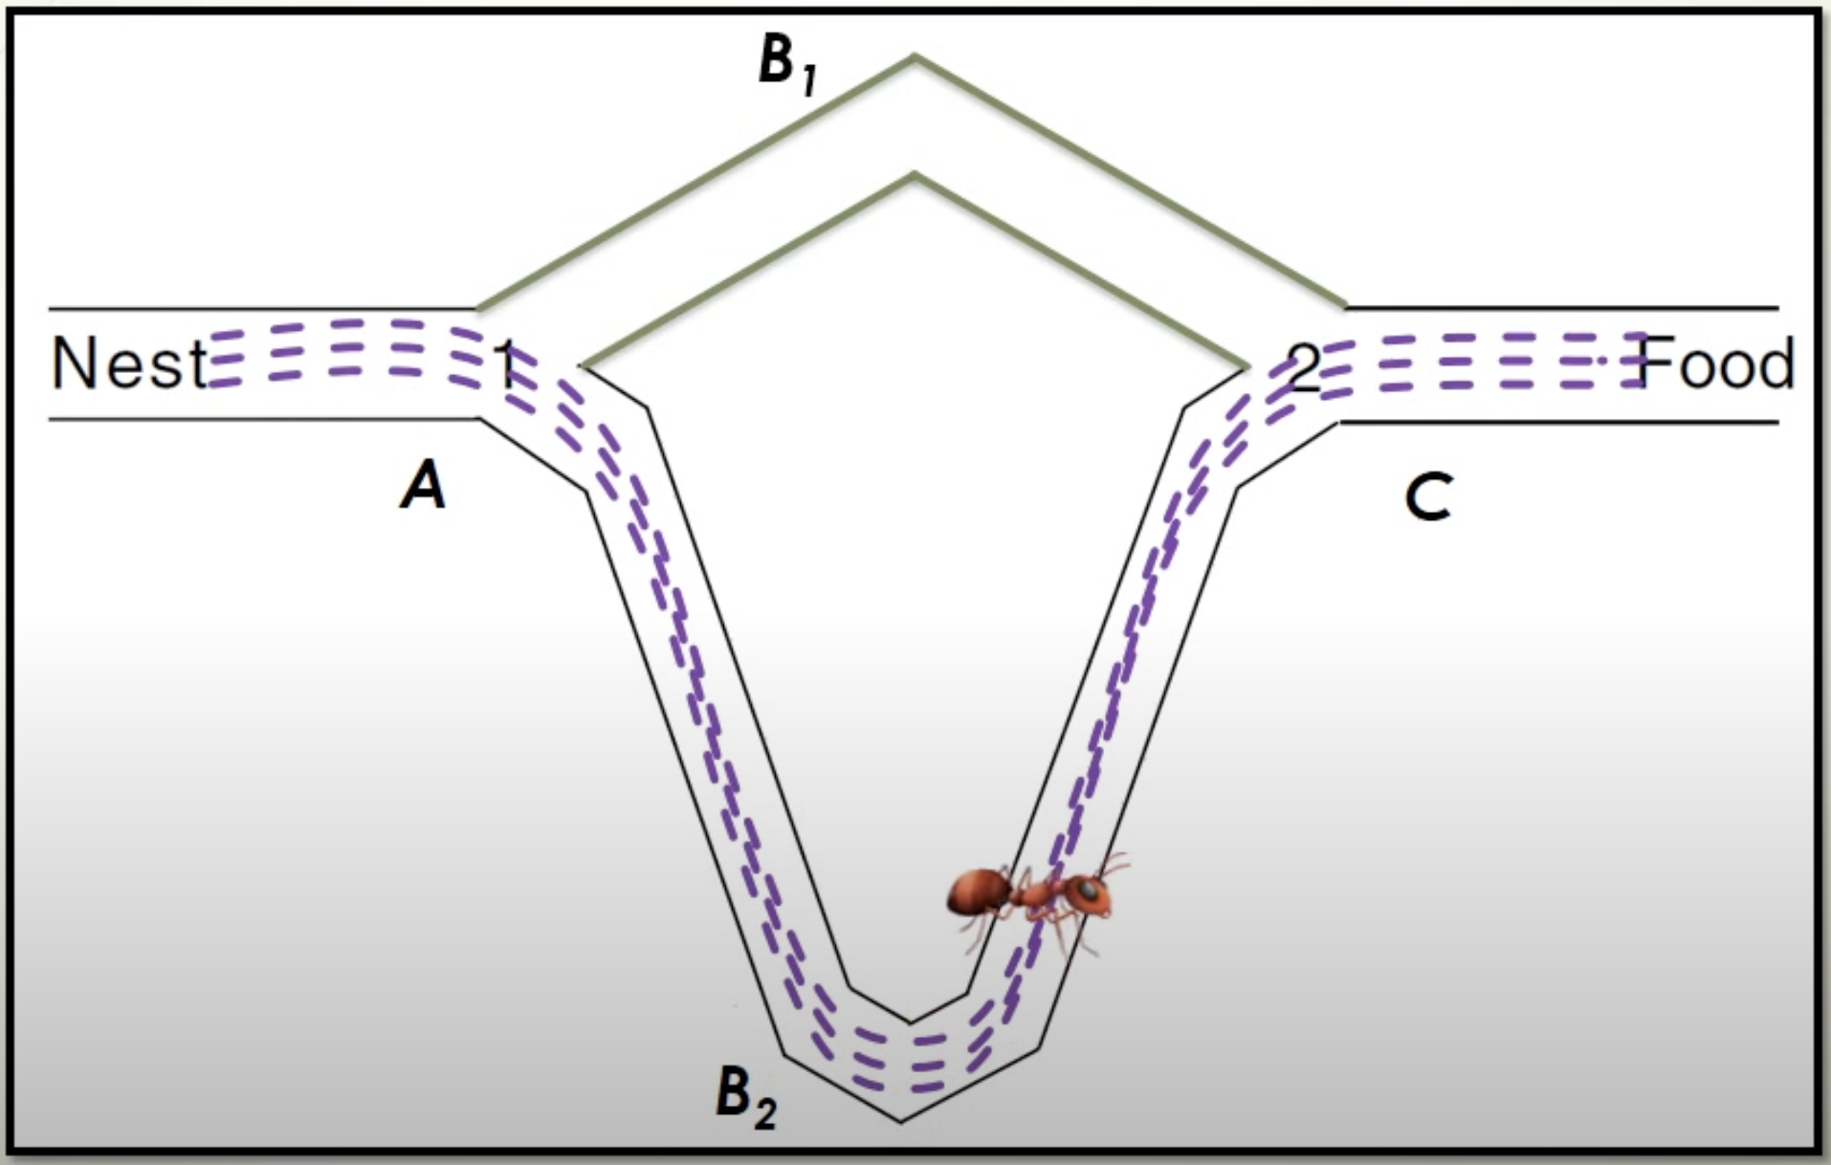
Opportunity Missed

Slide 21
Opportunity Missed
Intitially only the long branch.
After 30 minutes additional short branch.
The short branch was selected sporadically.
The colony was trapped on the long branch.

Slide 22
Stochastic Model of the Ant Colony
Proposed by Deneubourh et al., 1990; Goss et al., 1989
Describes the Dynamics of the ant colony
Probability of choosing the shırt path when starting at point i

Slide 23
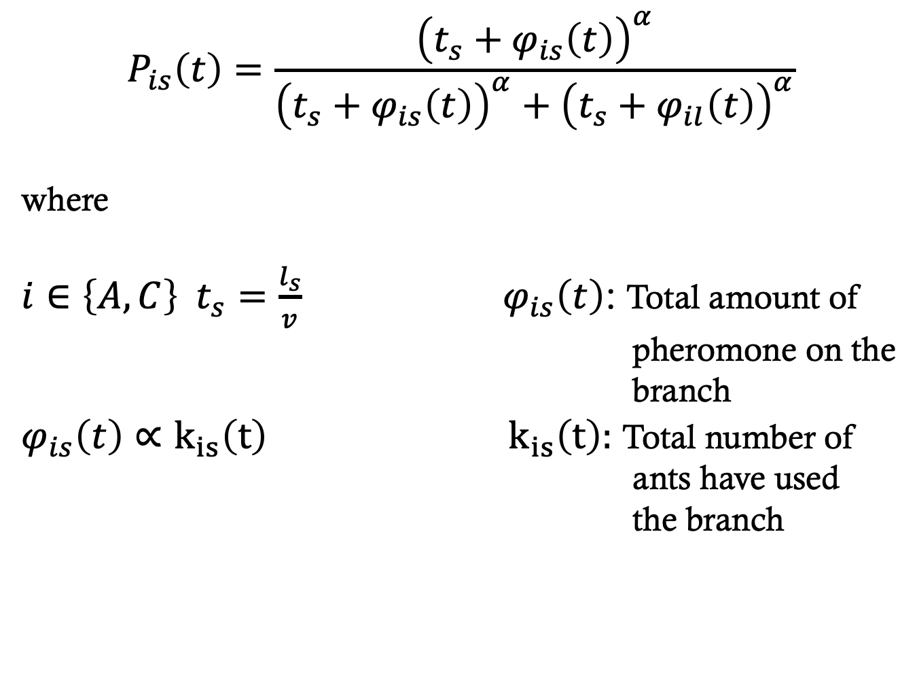
Stochastic Model of the Ant Colony
$$P_{is}\left(t\right)=\frac{{\left(t_{s}+φ_{is}\left(t\right)\right)}^{α}}{{\left(t_{s}+φ_{is}\left(t\right)\right)}^{α}+{\left(t_{s}+φ_{il}\left(t\right)\right)}^{α}}$$
where
$i∈\left\{A,C\right\} t_{s}=\frac{l_{s}}{v}$ ${ φ}_{is}\left(t\right)$: Total amount of
pheromone on the
branch $φ_{is}\left(t\right)∝k_{is}\left(t\right)$ ${ k}_{is}\left(t\right):$ Total number of ants have used the branch

Slide 24
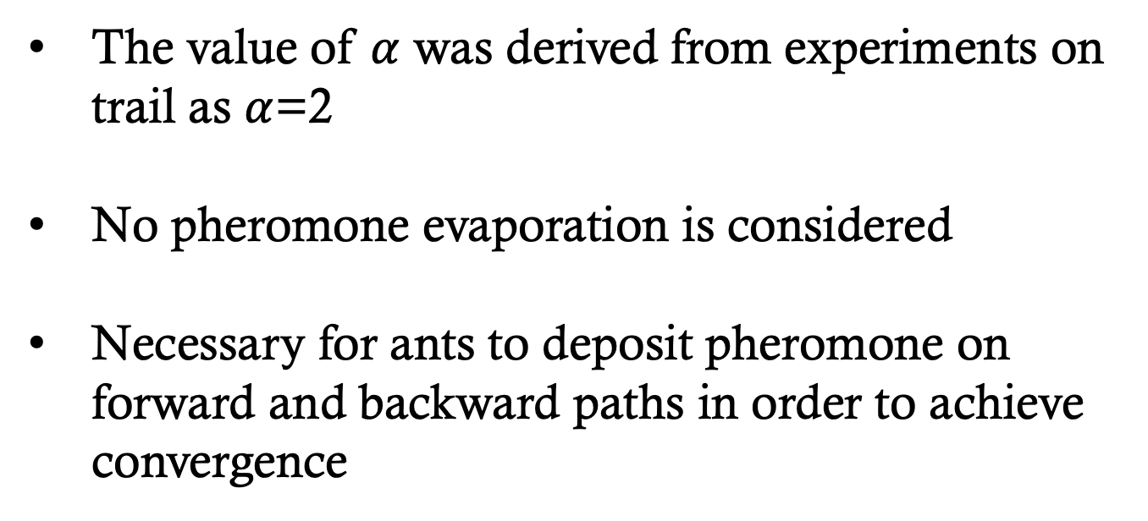
Stochastic Model of the Ant Colony
The value of $α$ was derived from experiments on trail as $α$=2
No pheromone evaporation is considered
Necessary for ants to deposit pheromone on forward and backward paths in order to achieve convergence

Slide 25
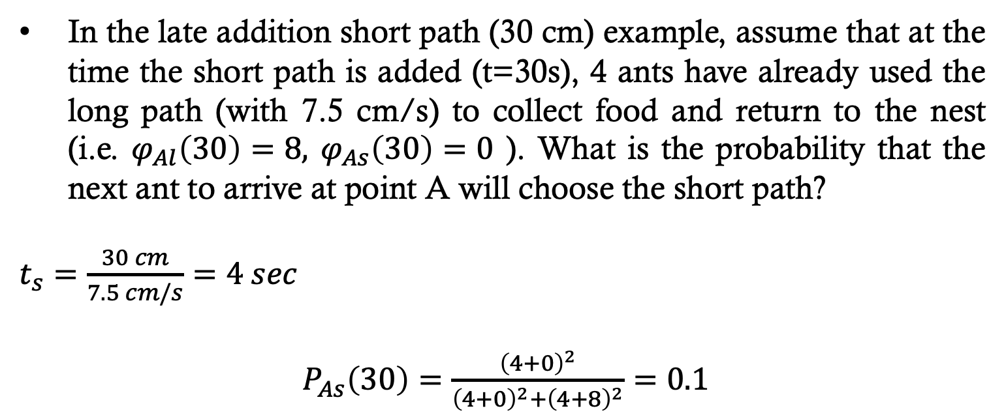
Stochastic Model Example
In the late addition short path (30 cm) example, assume that at the time the short path is added (t=30s), 4 ants have already used the long path (with 7.5 cm/s) to collect food and return to the nest (i.e. $φ_{Al}\left(30\right)=8,$ $φ_{As}\left(30\right)=0$ ). What is the probability that the next ant to arrive at point A will choose the short path?
$t_{s}=\frac{30 cm}{7.5 cm/s}=4 sec$
$P_{As}\left(30\right)=\frac{{\left(4+0\right)}^{2}}{{\left(4+0\right)}^{2}+{\left(4+8\right)}^{2}}=0.1$

Slide 26
Ant Colony Optimization
Characteristics of the algorithm
An ant is a solution.
Solutions (ants) are at different places in the solution space.
How they change is based on the probability of changing to a different schedule.
An ant completes its tour after selection a choice for each stand.
Utilities (objective function values) of each tour are calculated.
Pheromone levels are updated after all of the ants have completed all of their tours.

Slide 27
Ant Colony Optimization
Characteristics of the algorithm
The probability of moving from Point A to Point B depends on the attractiveness of the move and the trail level.
Attractiveness - an a priori desirability (typically based on the inverse distance) of the move.
Trail level - an a posteriori, computed attractiveness. This is computed after an ant
completes a solution, increasing or decreasing the desirabilities of components of a solution.
An ant completes its tour after selection a choice for each stand.
A
?
B

Slide 28
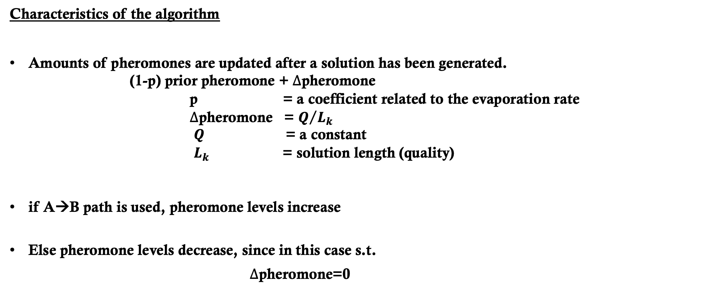
Ant Colony Optimization
Characteristics of the algorithm
Amounts of pheromones are updated after a solution has been generated.
(1-p) prior pheromone + $∆$pheromone
p = a coefficient related to the evaporation rate
$∆$pheromone = $Q/{L_{k}}$
$Q$ = a constant
$L_{k}$ = solution length (quality)
if A→B path is used, pheromone levels increase
Else pheromone levels decrease, since in this case s.t.
$∆$pheromone=0
A
?
B

Slide 29
Ant Colony Optimization
Advantage
It is intuitive to biologically-minded people, mimicking nature.
The system is built on positive feedback (pheromone attraction) and negative attractiveness (pheromone evaporation).
Pheromone evaporation helps avoid convergence to a local optima.
Disadvantage
For routing problems it may make more sense, but for harvest scheduling problems, it requires a conceptual leap of faith.
Fine-tuning the sensitive parameters may require significant effort.

Slide 30
Ant Colony Optimization
Necessary parameters
1) The initial population of ants (an ant cycle).
2) The total number of tours.
3) The evaporation rate.
4) The amount of pheromone applied to a section of a cycle or solution.
5) The constant Q.

Slide 31
Methodology
Parameters of ACO Algorithm
: Pheromone trail of combination (i,j)
: Local heuristic of combination (i,j)
: Transition probability of combination (i,j)
: Relative importance of pheromone trail
: Relative importance of local heuristic
: Determines the relative importance of exploitation versus exploration
: Trail persistence (pheromone decay rate)

Slide 32
The transition rule
is the amount of pheromone currently on the path that goes
directly from point i to point j.
is the heuristic value of this link – in the classic
application, this is chosen to be 1/distance(i,j) -- i.e. the shorter
the distance, the higher the heuristic value.
is the probability that ant k will choose the link that goes
from i to j
State Transition Probability:
Where our ant is at point i, and j is a point as yet unvisited on its
tour, and the summation is over all of k’s unvisited points

Slide 33
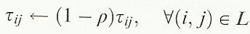
Global pheromone update
is amount of pheromone added to the (i, j) link by ant k.
NA is the number of ants
is a parameter called the pheromone decay rate.
L_{k} is the length of the tour completed by ant k
at the next iteration becomes:
Pheromone evaporation
Where

Slide 34
ACO
Generate initial ants
For all ants,
develop an ant tour
Basic Process
Assess the quality of the
ant tours
Change probabilities of
pieces of each
potential tour
Update pheromone levels
Has the
best solution
been improved?
Yes
Save best solution
No
Have we
reached the
stopping
criteria?
No
Yes
Stop and report
the best solution
found during search

Slide 35
